Slide 1


Team 60: Solar Lighting Syste
Bi-Weekly Update 3 Josh George, Jeb Malek, Lyric Haylow​ Sponsor: Dr. Wonhyeok Jang​ TA: Rhett Guthrie
Notes:
Michelle

Slide 2

Project Summary
A need for clean, renewable sources becomes more apparent than ever.
Our home indoor and outdoor lighting system is the first step towards this, using solar power.
Design an indoor/outdoor home lighting system that operates with a battery, power conversion, mobile application functionality, BT microcontroller for switch automation from motion sensors.
Notes:
Kyle

Slide 3
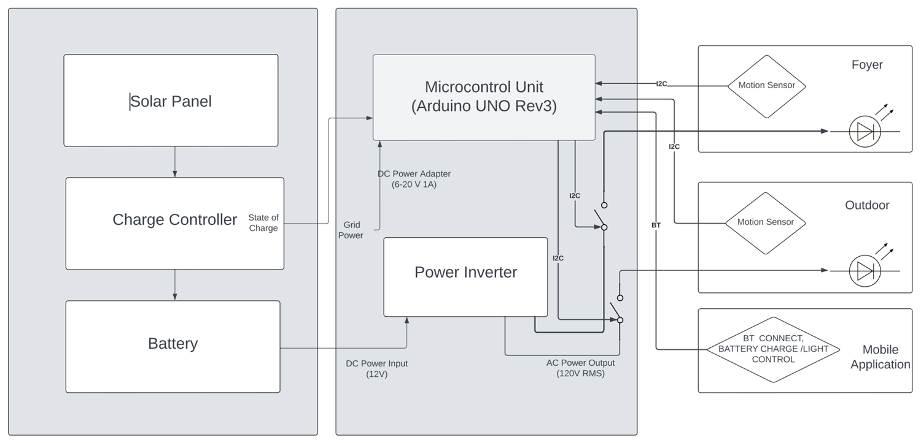
Project/Subsystem Overview
Notes:
Eric

Slide 4
Project Timeline
Subsystem Designs (completed 01/16) | Subsystems ordered and soldered (2/14) | Integration of Bluetooth and Arduino (to complete by 2/21) | Integration of Solar Charge Controller and MCU (3/9) | Final Integration (to complete by 3/15) | System Test (to complete by 3/21) | Validation (to complete by 3/25) | Demo and Report (to complete by 4/1)
Notes:
Eric

Slide 5
Solar Charge Controller
Accomplishments since last update 10 hrs of effort | Ongoing progress/problems and plans until the next presentation
PCB board soldered Gotten voltage output from one of the solar panels, confirmed working Preliminary datapoints for battery percentage attained. Likely wrong though. | Print 3D model for enclosure over Blitz Finish verifying necessary final values for Charge Controller Sun is temperamental and necessary for good testing.

Slide 6

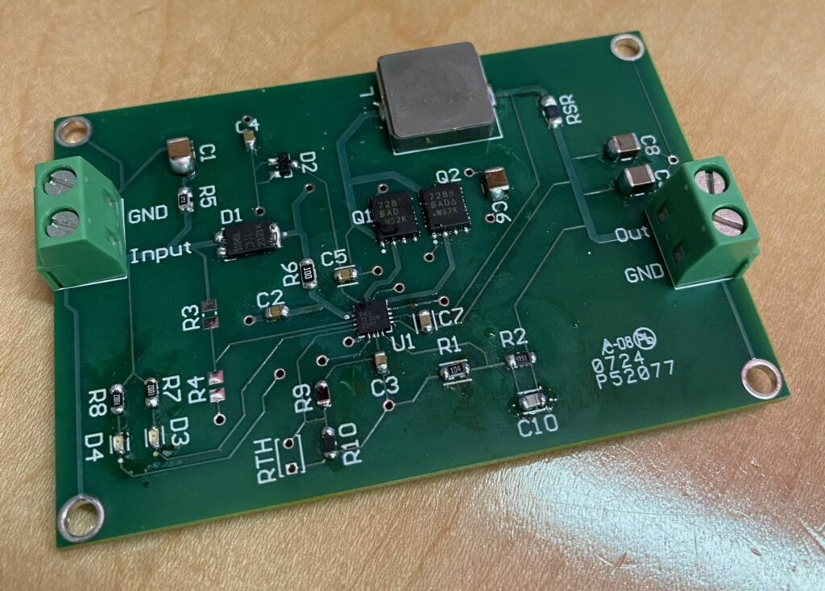
Time (AM) | Change in time (minutes) | Battery Voltage (Voltage
9:42 | 0 | 14.2
10:23 | 41 | 14
10:33 | 51 | 14.3
10:43 | 61 | 14.01
Solar Panel to battery testing using provided Charge Controller, introduces sun issues

Slide 7
Inverter Subsystem
Jeb Malek
Accomplishments since 403 25 hrs of effort | Ongoing progress/problems and plans until the next presentation
Power transformer voltage invalidated In-circuit serial programming issue | PCB Correction Ordering Corrected Version Assembly & Validation 12V – 5V Converter PCB Order
Evaluated Configuration Bits for Programming dsPIC
Speaking with sponsor about alternative changes to scope.

Slide 8
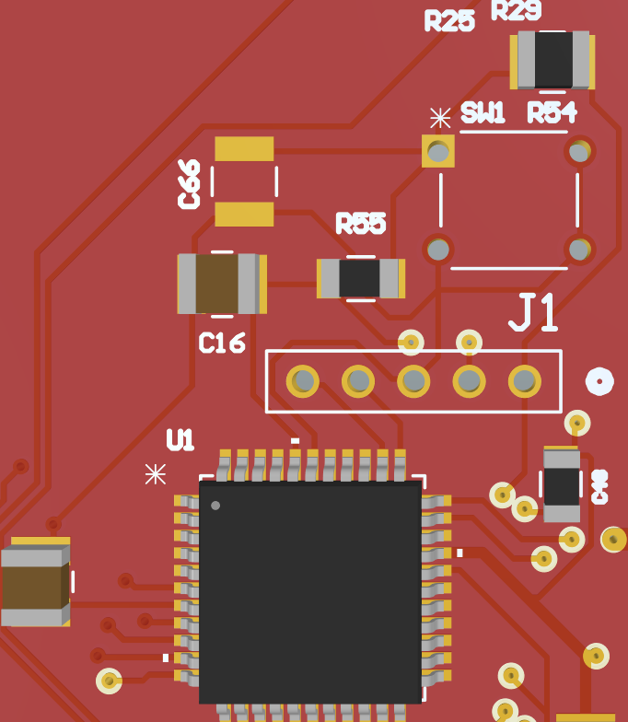
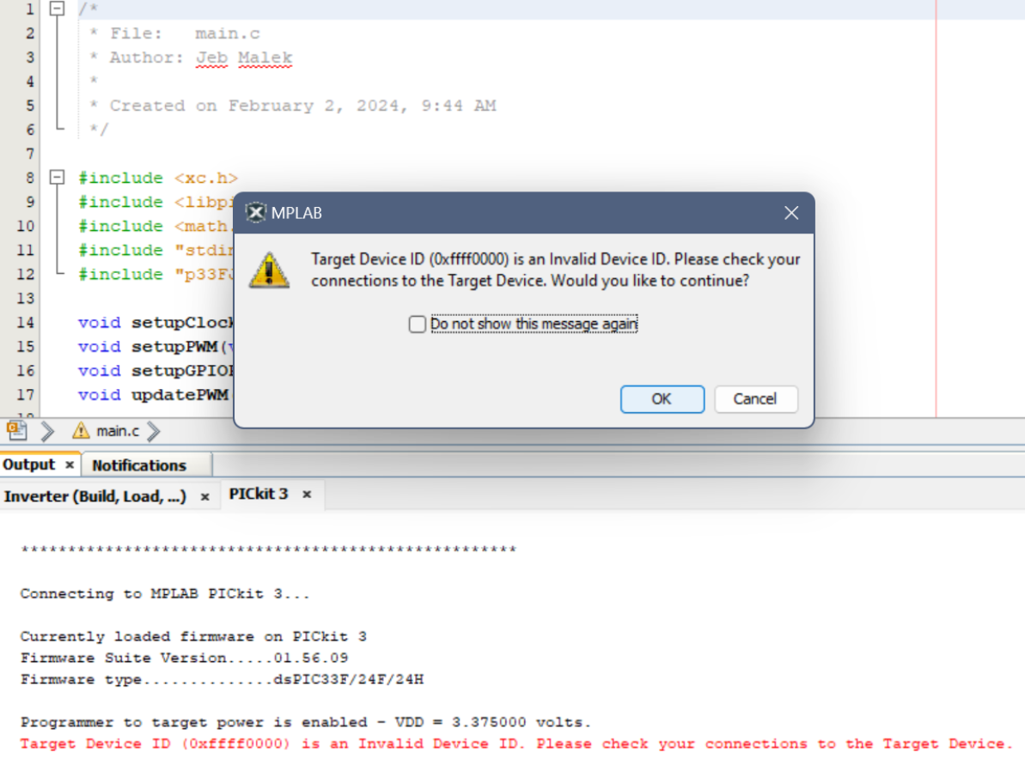
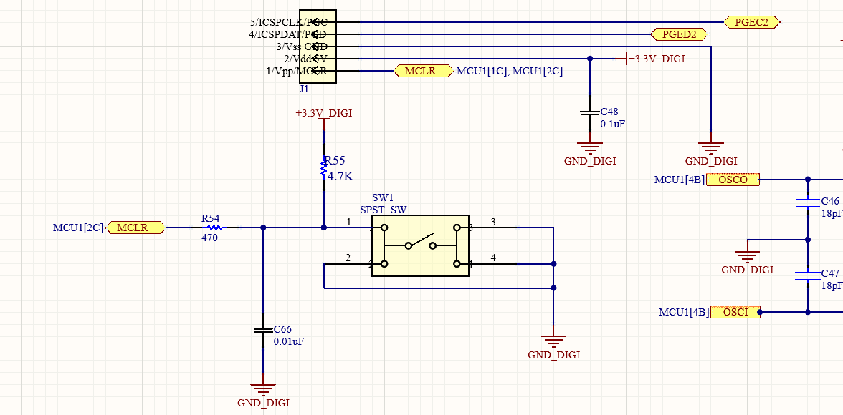
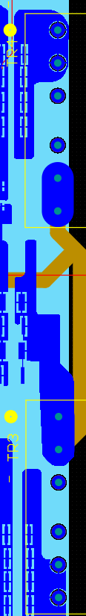
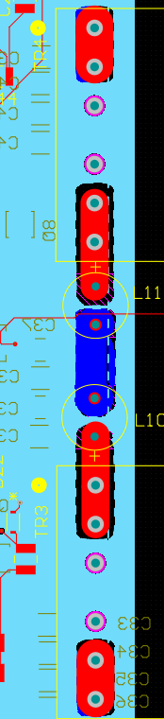
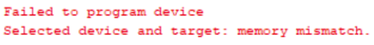
Inverter Subsytem
Jeb Malek
Verification DSPIC33FJ16504
Target Device ID Connection Issue
PCB Error Edit Ground Polygon Cutout / Via Solid Connections

Slide 9
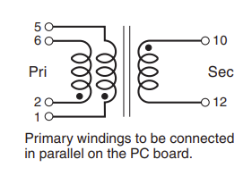
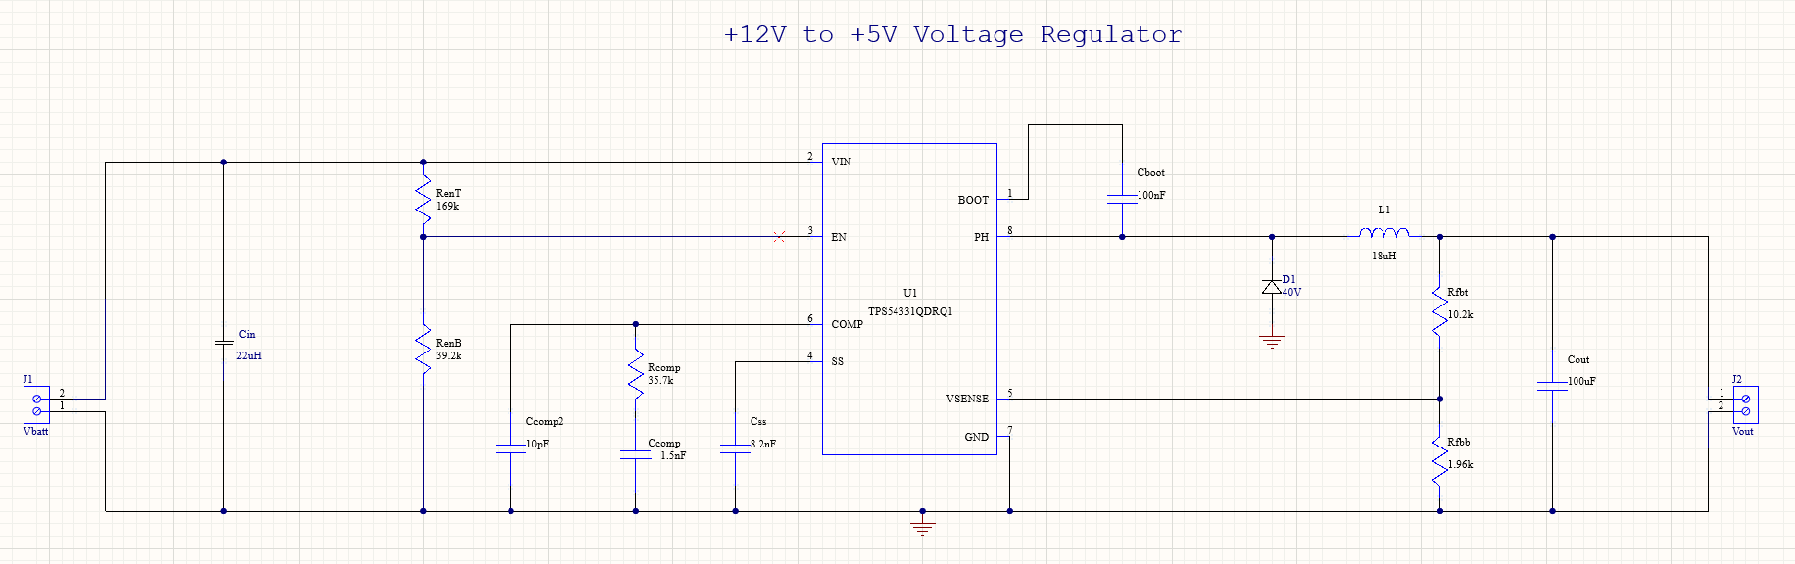
Inverter Subsytem
Jeb Malek
Transformer Schematic
Converter Schematic

Slide 10
Microcontroller Subsystem
Jeb Malek & Josh George
Accomplishments since 403 20 hrs of effort | Ongoing progress/problems and plans until the next presentation
Passive Infared (PIR) Sensors Tested Coded microcontroller sensor relay information | Testing of Sensor proximity & distance Testing of Controlled Relay Communication with Arduino Testing of Relay with Light Load
Evaluated Sensor High & Low Communication Signal
Future Test Bluetooth App with relay control, receive of motion sense, sign of demonstration structuring

Slide 11
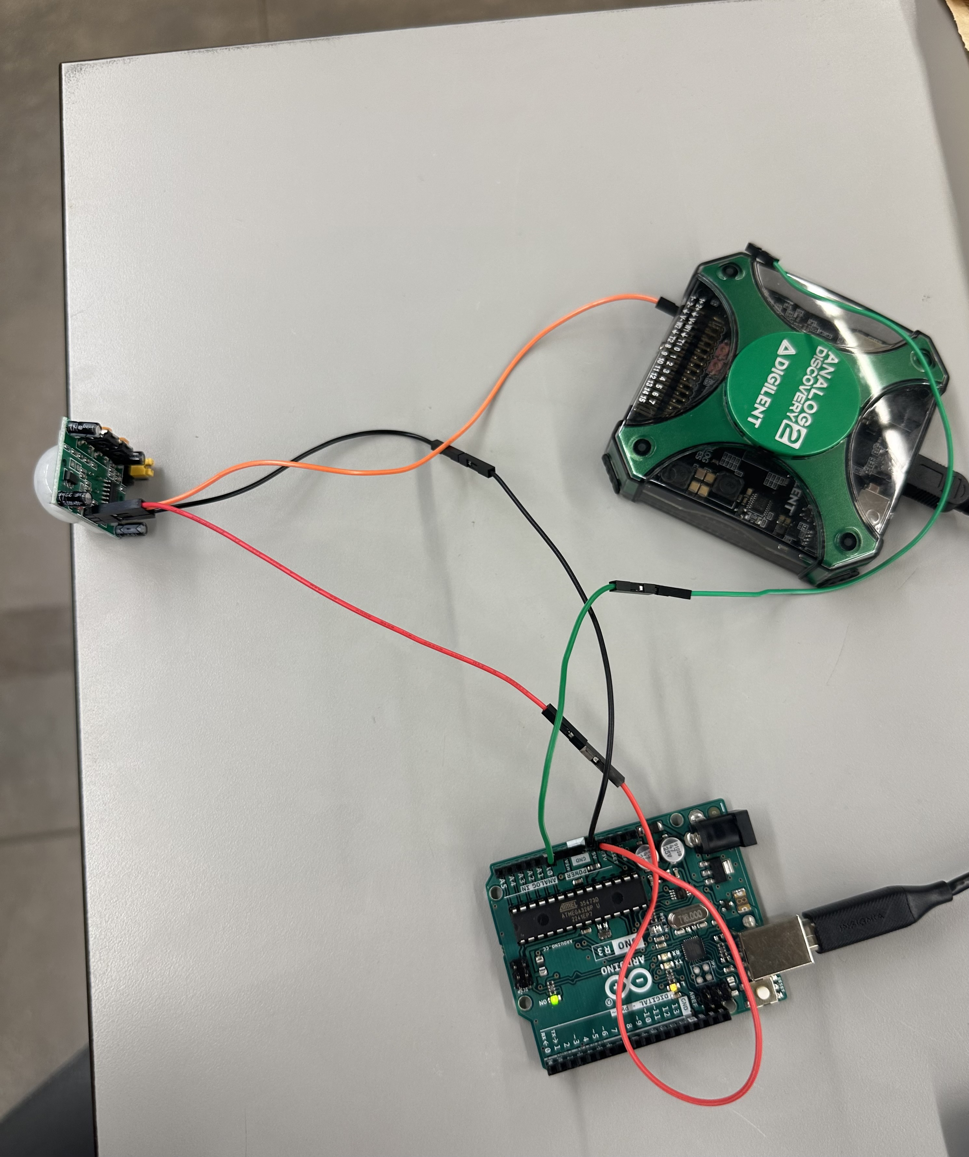
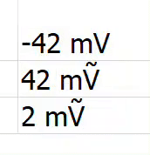
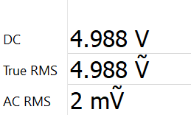
Microcontroller Subsytem
Jeb Malek & Josh George
PIR Motion Sensor Test

Slide 12
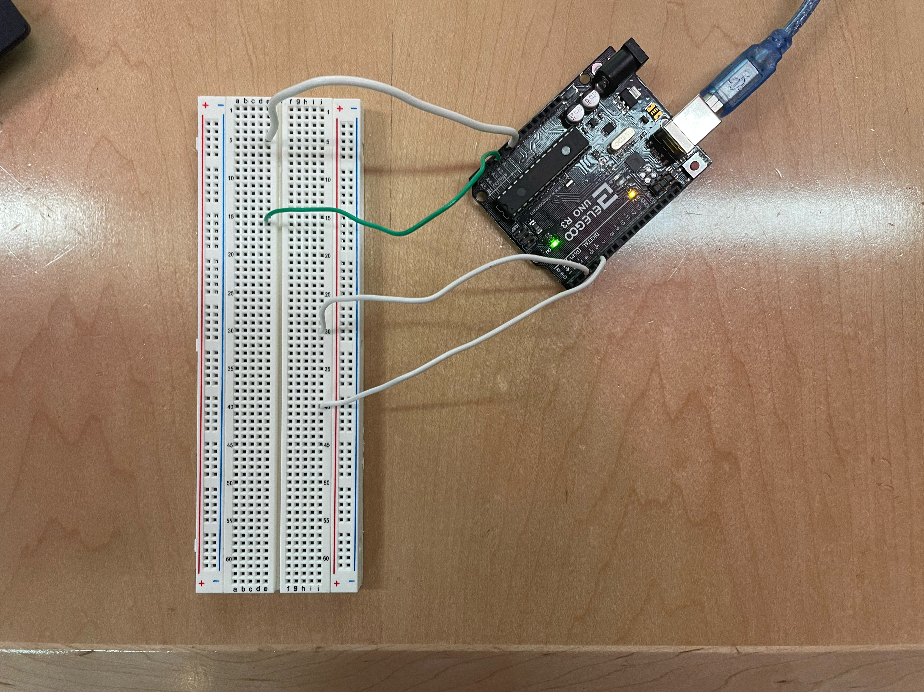
Microcontroller Subsytem
Jeb Malek & Josh George
Sensor 1 Reading Pin
Sensor 1 Lights

Slide 13
Microcontroller Subsytem
Jeb Malek & Josh George
Sensor 2 Reading Pin
Sensor 2 Lights

Slide 14
Microcontroller Subsytem
Jeb Malek & Josh George
Main error found during testing: Sensor 1 activates Sensor 2 lights too, and Sensor 2 activates sensor lights as well.

Slide 15
Mobile Application
Josh George
Accomplishments since last update 2 hrs of effort | Ongoing progress/problems and plans until the next presentation
-Added Bluetooth special characters functionality. | -Finish coding microcontroller sensor relay. -Add input pin option for solar charge controller.

Slide 16
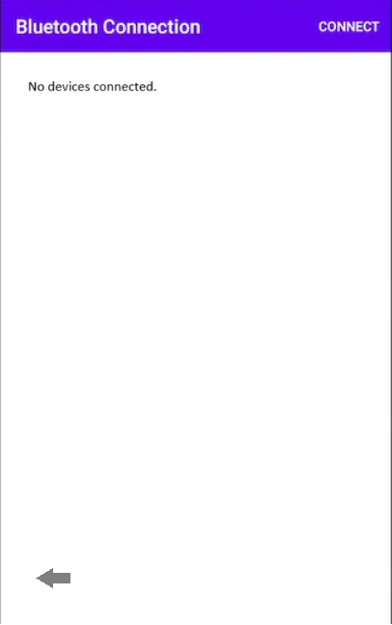
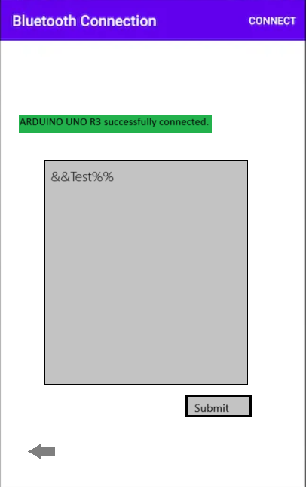
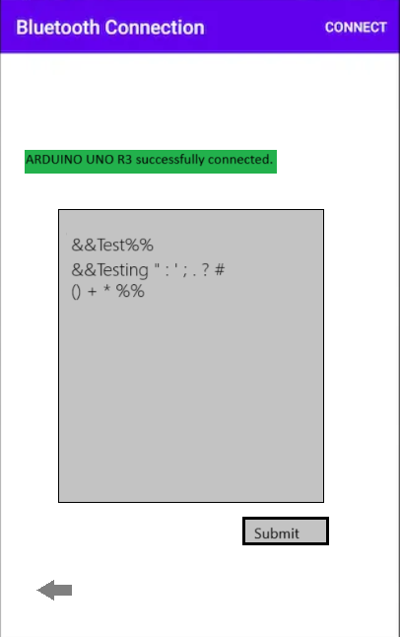
Mobile Application
Josh George

Slide 17
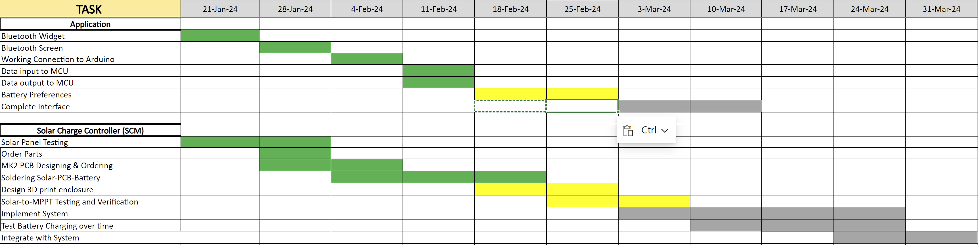
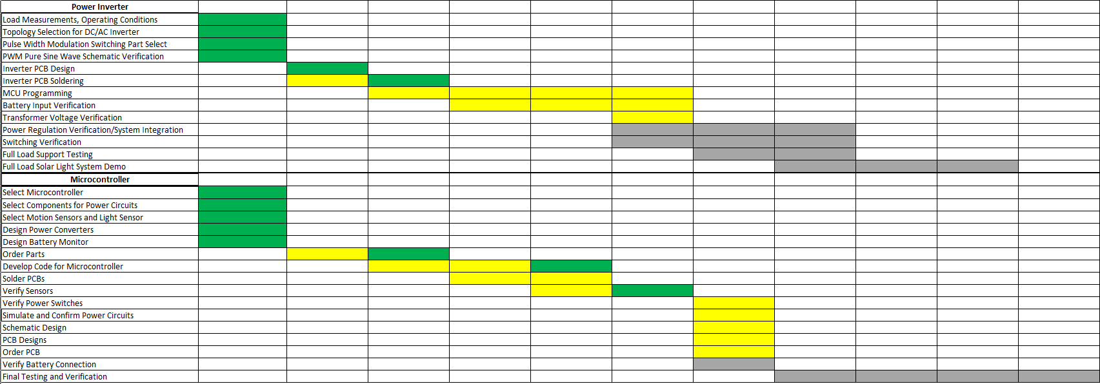
Execution Plan
Notes:
Michelle

Slide 18
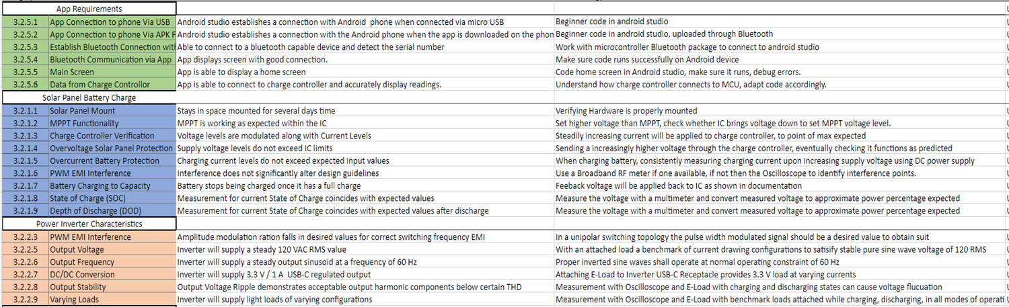
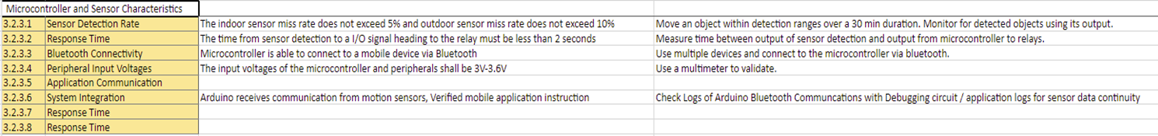
Validation Plan

